Slide 1
Stockton Springs Community Library SSCL catalog search
Stockton Springs Community Library has re-opened as of June 1, 2020 . Covid-19 related restrictions are in place to make the library a safe place for you, your family, and our volunteer library staff.
The new rules are posted on the library door, our Facebook page, and website. Please call during library hours if you have questions or concerns.
One way you can make your visit safer and faster is to search our catalog online and request items in advance of your visit. You can also check to see if an item is available before you come.
The following slides provide instructions and examples on how to access the library catalog from our website.
Make your selection then
phone 207-567-4147
or email (Subject: pick up order request) stocktonstaff@stocktonsprings.lib.me.us

Slide 2
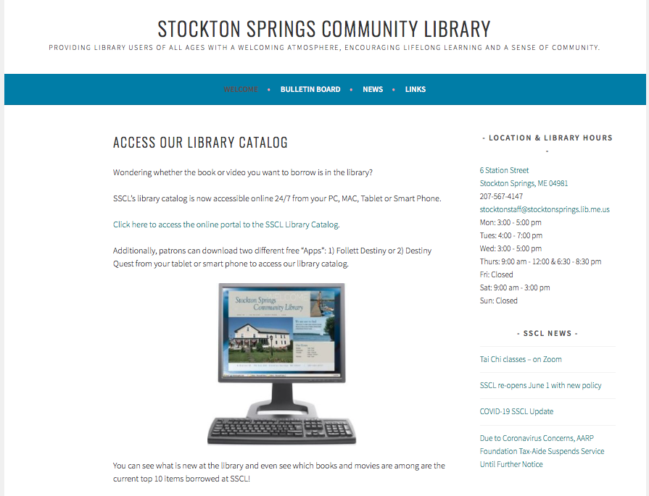
Stockton Springs Community Library SSCL catalog search tools
SSCL website https://stocktonspringslibrary.org/
Direct link to catalog Follett Destiny - SSCL Catalog

Slide 3
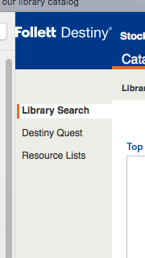
Stockton Springs Community Library SSCL catalog search instructions
From the SSCL webpage link to the catalog, choose “library search” and then click
Stockton Springs Community Library

Slide 4
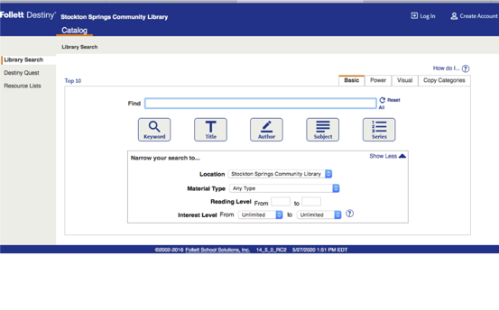
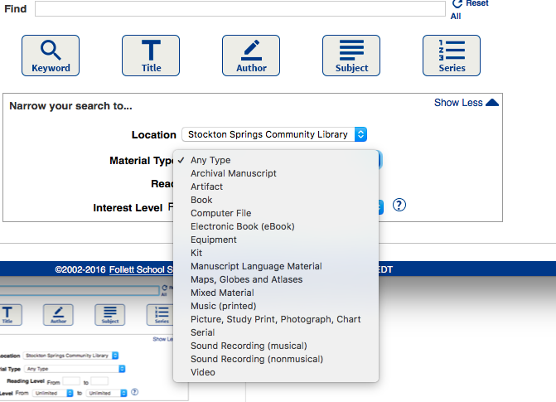
Stockton Springs Community Library SSCL catalog search instructions
Use the “find” box on the Basic Search tab screen to search for the item you are interested in, then click the appropriate category: Keyword, Title, Author, Subject, or Series.
You can also enter the Material Type in the drop down box just below the find box.
Two other options along side the Basic Search tab are: Power Search and Visual Search, which give you other ways to search.

Slide 5
Stockton Springs Community Library SSCL catalog search example
Here’s an example of a search. After typing in Stockton Springs author “Mac Smith” in the find box, the category “Author” was selected. The search result shows his book “Mainers on the Titantic” with the call number 910.91 SMI is available at the library. The number indicates where the book is shelved at the library. His latest book will be available at SSCL very soon.
You can also browse authors or further refine your search.

Slide 6
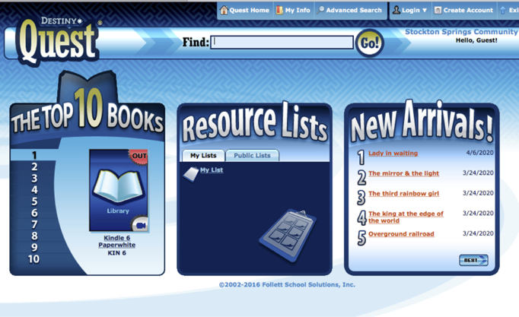
Stockton Springs Community Library SSCL catalog search using Destiny Quest
Another tool available on our website is called Destiny Quest. This tool allows you to see what are the top 10 items in circulation from our library.
The tool also lists New Arrivals, so if you’ve been waiting for a new book or movie to be available at SSCL, this is the place to check first.

Slide 7
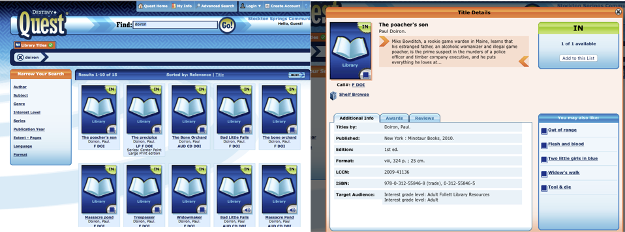
Stockton Springs Community Library SSCL catalog Destiny Quest - example
Here’s an example of a search in Destiny Quest for books by Maine author Paul Doiron. As you can see quite a few are available since we’ve been closed for awhile. If you click the book image you will be able to get more information about the book. You can also “Shelf Browse from here, which will be described on the next slide.

Slide 8
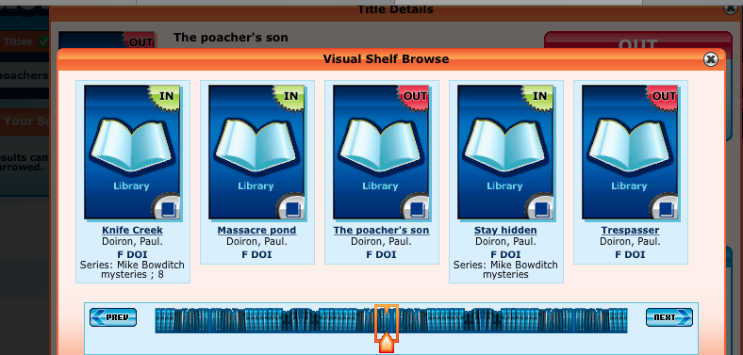
Stockton Springs Community Library SSCL catalog Destiny Quest – shelf browse
Do you like to visit the library so you can look at all the titles and perhaps randomly find a book you’d like to read or movie for the night? You can do this from home too! Just like in the library you need to start somewhere.
Check the box “shelf browse” (see previous slide) and more books will be listed along with their availability.
This works for movies too.
By paging left or right you can see other books and movies “on the shelves” that you might be interested in.

Slide 9
Stockton Springs Community Library
Once you have chosen your books and/or movies, call or email the library to have them ready for pick up at the circulation desk during library hours. We will do our best to have them ready for you to pick up.
You can also come in to the library with your list and find the book or movie yourself, search the stacks like you used to, just remember to wear a mask and follow the new library rules. If you don’t want to come in the building we can hand them to you on the porch.
Phone: 207-567-3144
Email: stocktonstaff@stocktonsprings.lib.me.us
Library Open Hours: Mon: 3:00 - 5:00 pm Tues: 4:00 - 7:00 pm Wed: 3:00 - 5:00 pm Thurs: 9:00 am - 12:00 & 6:30 - 8:30 pm Fri: Closed Sat: 9:00 am - 3:00 pm Sun: Closed
Please use the subject line in your email: pick up order request. Provide as much information as possible.
Your name (required)
Best phone number to call or text you (required)
Book/movie title and format (ex. Kindle, hard print, audio book, DVD)
Author/actor(s)
Call number (if you know it)
Date you would like to pick it up (optional)

